Slide 1
Memory Management
Chapter 7
Last Updated 2/28/2018 1:59 PM

Slide 2
Memory Management is responsible for...
Relocation of a process image in physical memory.
Protection of a process image from access by other processes and from accessing the kernel’s memory.
Providing every process exclusive access to a region of memory.
Shared Memory i.e. the deliberate sharing of blocks of memory between two or more processes.
Defining ‘special’ physical memory which is available to two or more processes.

Slide 3
Process Image Relocation
Relocation occurs when a process is loaded, suspended, and then reloaded back in to memory at a different address.
The image is ‘relocated’ to different location in physical memory.
Notes:
MMU is located on Intel’s Northbridge chip / controller.

Slide 4
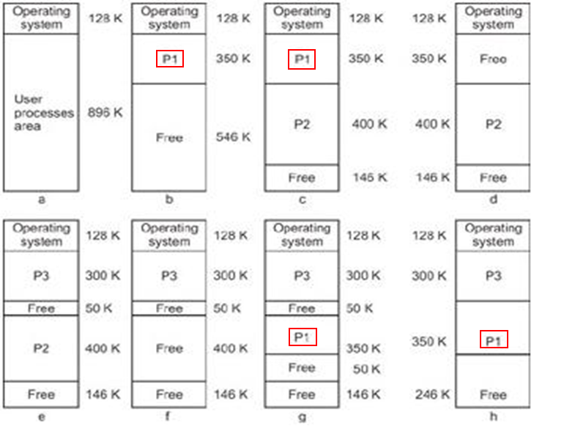
Notes:
Process P1 is relocated from one memory region to another.
Also note how the free regions in the last diagram are combined (compacted) into a single free region.

Slide 5
Protection
A process cannot reference the memory that has been loaded with the memory pages (instructions or data) of a different process.
A process cannot reference the memory that maintains the operating system’s instructions and data (buffers, etc.) i.e. the kernel space.
Because a process image can be relocated anywhere in memory, enforcing memory protection becomes an extension of the same mechanisms that allows relocation.

Slide 6
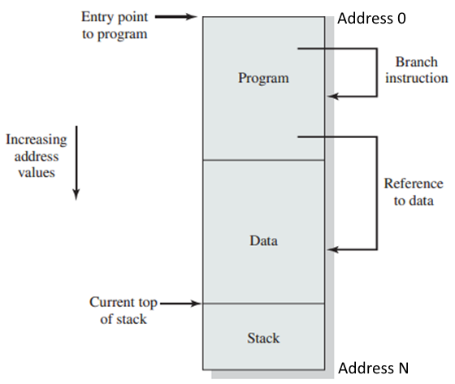
Review: The Organization of a Process Image
Notes:
Key point: The process image ‘logically’ starts at address zero and extends to the size of the image (N).

Slide 7
Logical View of Process Memory
Logically (from the programmer’s perspective) the process image appears as a single block of continuous memory.
Containing the regions shown on the previous slide, more or less as generated by the OS loader.
The logical view maintains the illusion that every process has an address space that is separate from all other processes.
Every process is provided with a logical address range 0-N although each is located at different physical address ranges.
For example, each processes can read data the same logical address, but accesses two different physical addresses.
Notes:
The same module (e.g. DLL / SO) may be located at different addresses in each processes image accessing the shared module.

Slide 8
Physical View of Process Memory
The process image is installed at a location in physical memory.
The actual address depends on the memory regions that were free (unoccupied) when the process was started.
Paged memory management can spread an image across many non-contiguous pages (sections) of physical memory.
The process can be relocated into several physical locations throughout its lifetime e.g. swap out and swap back in.
Memory management maintains a separate logical view for every process when in reality the processes are loaded into different regions of common physical memory.

Slide 9
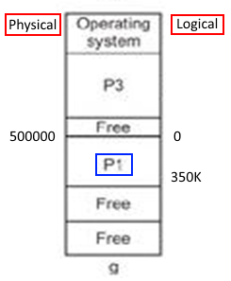
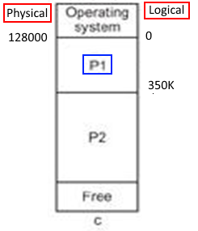
Physical and Logical Addresses of a Relocated Process
P1 can be physically relocated to a new locations in the Physical Address Space , but retains the illusion of a Logical Address Space that starts with location 0 with a length of 350K bytes.

Slide 10
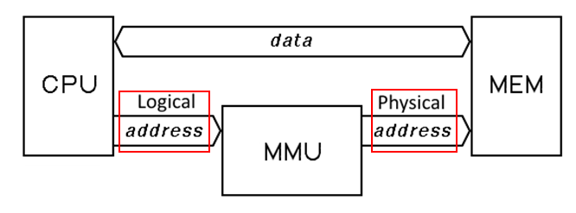
Memory Management Unit (MMU)
Memory Management is a hardware solution that :
Calculates a physical address from the process’s logical address.
Ensures that the physical address belongs to the process.

Slide 11
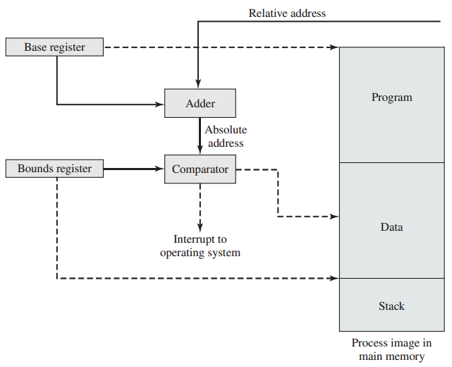
Primitive Memory Management Unit Hardware
Notes:
Every process maintains the Base and Bounds register contents in its process control block.

Slide 12
Two Types of Memory
Recall the two tiers of memory:
Main memory (RAM) is fast but expensive so has limited capacity.
Secondary memory (Disk) is cheap but slow so it is not practical for the processor to execute directly from secondary memory.
Recall that a process image is built and maintained on the system drive.
But the image must be copied into main memory before it can be executed.
For example, a suspended process will not occupy memory.

Slide 13
Memory Partitioning
The remainder of this section describes techniques of placing process images into physical memory.
A Partition is the block of physical memory into which a process image has be loaded for execution.
The system’s physical memory is divided into multiple partitions:
Fixed Partition whose size does not change after its are created.
Dynamic Partition whose size changes according to image size.
Both partition types require a placement algorithm that determines which memory partition a process is assigned to.
Notes:
Most of these partitioning techniques are obsolete but form the basis for modern virtual memory management.

Slide 14
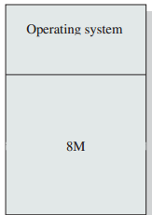
No Partitioning
The earliest operating systems single process (not multi-process).
Only a single process / image can be executed at a time.
An image is loaded, executed to completion, and replaced with the next process / image to be executed.

Slide 15
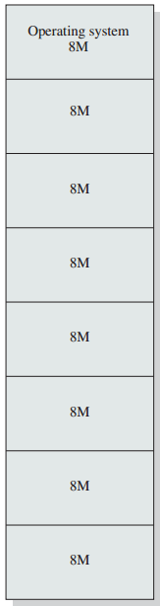
Fixed Partitioning
Memory is divided into N fixed and equally sized partitions during system initialization.
Process images are loaded into one of these partitions for execution.
Problems with fixed partitioning:
A process image may be too large to fit into a partition making it impossible to load.
When a process image is smaller than the fixed partition, there is unused, wasted memory.
The unused memory inside the partition is called Internal Fragmentation.
Notes:
The operator needs to configure the OS to produce fixed size partitions large enough to fit the largest program / process needed by the enterprise and so exasperating the problem of internal fragmentation.

Slide 16
Dynamic Partitioning
Memory Partitions are dynamically created with a size determined by the process image being loaded.
Partitions are released (unallocated) when the process exits.
Internal Fragmentation is Eliminated because partition sizes are determined by the size of the loaded process image.
But the creation and removal of processes can create regions of unallocated memory too small to load ready processes.
These unusable regions are called External Fragmentation.
External Fragmentation is the unusable space between processes.
Notes:
See example on next slide.

Slide 17
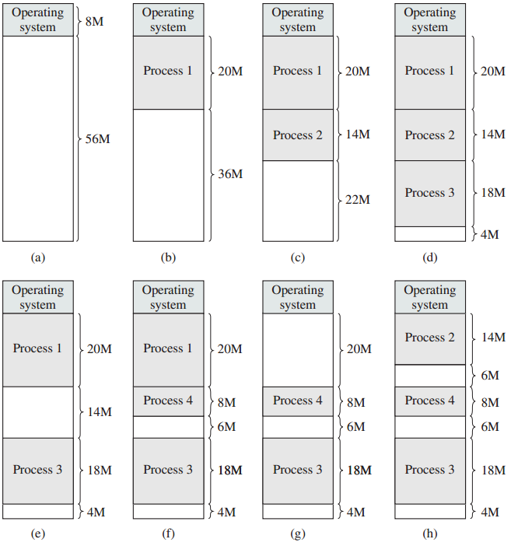
Notes:
How large a free memory region will be created when H is compacted? (16m)

Slide 18
Compacting Dynamic Partitions
External Fragments can be ‘compacted’.
Resident processes are shifted up (or down) to consolidate the small regions into a single large, usable region.
Compacting involves moving large blocks of memory and so is very expensive in terms of processing overhead.

Slide 19
Dynamic Partitioning Placement Algorithms
These are algorithms used to determine which free region to load a ready Process into.
Best-Fit: The OS picks the smallest of all the free region that is large enough to contain the process.
First-Fit: The OS picks the first region starting from the top of memory that is large enough to hold the process.
There may be free regions that are a better fit (i.e. with less external fragmentation) lower in memory, but they are ignored.
Next-Fit: The OS picks the first region starting from the previously allocated region that is large enough to hold the process.

Slide 20
Dynamic Partitioning
Dynamic Partitioning eliminates internal fragmentation, but introduces external fragmentation between partitions.
Requires a placement algorithm to identify suitable regions.
Requires regular partition compaction which is wasteful of processor resources and reduces system performance.

Slide 21
Paged Memory
Fixed and variable sized partitioning results in wasted memory due to internal or external fragmentation.
Paging is a memory management scheme that has…
Memory divided into small equally sized partitions called Frames.
Process Image divided into equally sized regions called Pages.
A process’s pages are placed into unoccupied (free) memory frames.
Notes:
Frame size is typically 4096 (2¹²).

Slide 22
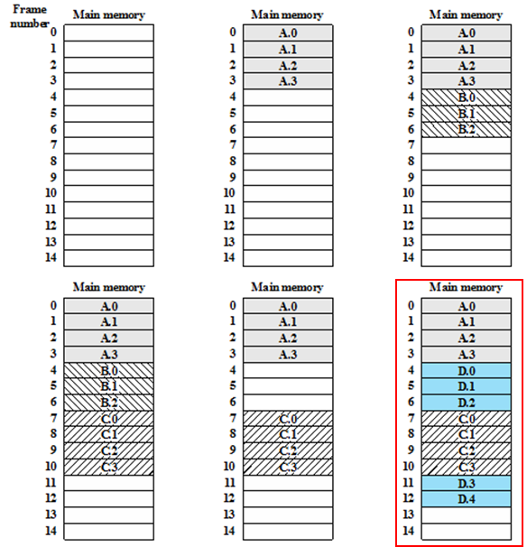
The Layout of Multiple Processes into Memory Frames
Process pages are placed into memory frames.
Note that Process D’s pages are not placed into contiguous memory frames.
Paging allows an image to be spread throughout main memory.
Notes:
Each memory frame is either empty or contains a page from one of four processes.

Slide 23
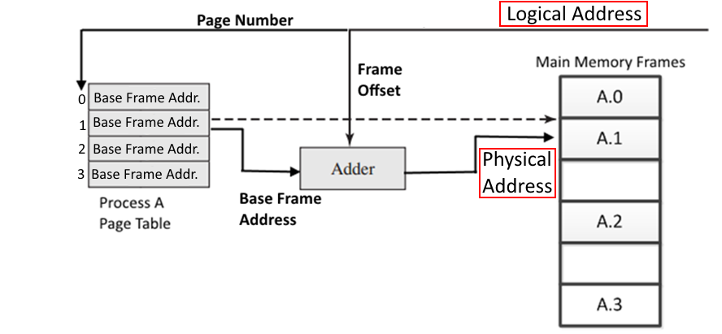
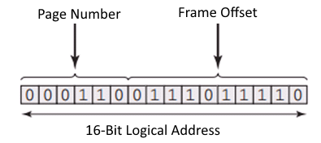
Paged Memory Mapping Maintaining the Logical to Physical Mapping for Process A

Slide 24
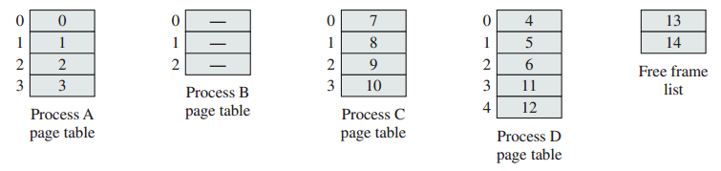
The Process’s Page Table
Every Process maintains a Page Table of Frame Addresses allocated to the process.
The Page Table maintains the Base Address of every Frame.
The Logical Page Number is used to index the page table to identify the Page Table Entry with the physical base address of the memory frame the page is loaded into.
A Process’s Page Table is maintained in its Process Control Block.
Notes:
The page tables show above correspond to the memory map on slide 30 highlighted in red.

Slide 25
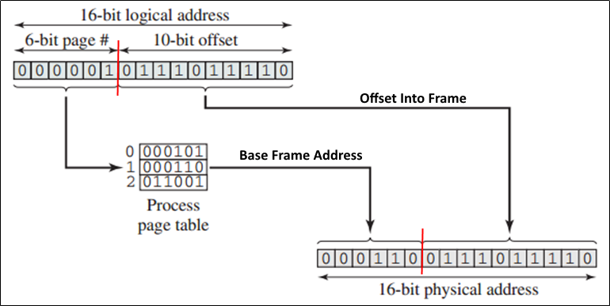
Paging Hardware Logical to Physical Address Translation N = 6; M = 10;
The linker produces the process image as a contiguous block of memory and paging redirects every logical address to the correct physical address anywhere in physical memory.

Slide 26
Logical to Physical Address Translation
To simplify translation, the page size is a power of 2.
Allowing the offset to be wholly maintained by M bits.
The page size is fixed by hardware. For example, the Intel Memory Management Unit (MMU): M=12 or 4096).
Translating logical address to physical address:
The high-order N bits of the logical address is an offset into the process’s page table identifying the frame’s base address.
The low order M bits of the logical address is a frame offset into the frame identified by the page table entry.
Producing the physical address by concatenating the frame’s base address with the frame offset.

Slide 27
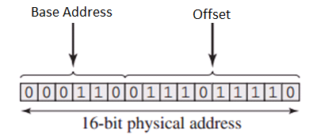
Importance of Powers of Two
Using a page size that is a power of two illustrates how physical address are generated.
The Base Address of the allocated frame. (2⁶ = 64 frames).
An Offset within the frame. (2¹⁰ = 1024 byte frame).
Concatenating these two values into a single N-bit physical address is simply (quickly) accomplished in hardware.
Notes:
Virtual Memory makes use of fixed length partitions (typically 4096 bytes).

Slide 28
Simple Paging
The qualities of Simple Paging:
The partitions (frames) are very small.
Each frame’s location is maintained in the process’s page table.
A process image occupies multiple frames.
The frames occupied by the image need not be contiguous.
Paging produces:
No external fragmentation.
A small amount of internal fragmentation for some frames.
Pages can be added or removed allowing a process’s memory footprint to dynamically grow or shrink in size.

Slide 29
Shared Memory
Pages of memory shared between two or more processes.
Each process has the same pages mapped into their process image.
The kernel region is included in each process image.
Although still protected, the same kernel memory pages are mapped into every process.
Shared memory is also used when:
The memory contains data regions (buffers, arrays, etc.) which two or more processes are cooperatively manipulating i.e. for the purposes of inter-process communication.
The memory containing program or library instructions are referenced by two or more processes e.g. .dll and .so files.
Notes:
What is the difference between ‘shared memory’ between processes and between threads?

Slide 30
Linux Shared Libraries
Shared libraries are loaded from disk into frames.
A library is only loaded once into memory (saving significant memory).
The library’s frames will be shared with processes that use the library.
During process initialization, the executable file is examined and the shared libraries it uses are identified.
Some libraries (e.g. libc.so) are needed by every process.
The library’s frames are mapped to every process that links with the library⁽¹⁾.
Notes:
.so – shared object library.
(1) The actual process of sharing (or not) a library is discussed in http://unix.stackexchange.com/questions/116327/loading-of-shared-libraries-and-ram-usage
Also…the_inside_story_on_shared_libraries_and_dynamic_loading.pdf in supplemental materials folder.

